Slide 1

Movie Dialog QA Bot
Semantic Search with Grounded Evidence
A grounded, explainable semantic retrieval system for conversational data
Sudarsan Nallur Murali

Slide 2
Executive Summary
Business Case
Solution
Users want to ask natural language questions like:
“who says we’re running out of time?”
“dialog about artificial intelligence”
Build a searchable, deployable prototype that returns verifiable dialog lines with metadata.
We need results that are Relevant, Fast and Grounded

Slide 3
Why This Approach?
Approach | Grounded | Explainability | Paraphrase Handling
Keyword Search | Returns exact text | Simple match algorithm | Brittle and misses synonyms
Generative LLM | High risk of hallucination | Opaque (Black box) | Excellent
Semantic Retrieval (Embeddings + vector index) | Returns exact evidence | Similarity score is inspectable | Core strength

Slide 4
Data & work around
Dataset source
Initially tried Hugging Face dataset loader for Cornell Movie Dialogs
It failed because the upstream Cornell download link was unavailable (cornell_movie_dialogs_corpus.zip)
Solution we used
Switched to ConvoKit’s movie-corpus (stable hosted corpus)
Download + load via:
Corpus(filename=download("movie-corpus"))
Second issue
Utterances didn’t initially include movie metadata (movie/year showed as None)
Fix
Extracted movie info from conversation.meta and merged onto utterances
Confirmed fields using inspection script (03a_inspect_convokit_fields.py)

Slide 5
Project Workflow
Embed text using sentence-transformers/all-MiniLM-L6-v2
Load corpus (ConvoKit movie-corpus)
Flatten data → one row per utterance
Build FAISS index using cosine similarity
Streamlit Search UI
Save artifacts

Slide 6
Result (Input → Output)
Output (grounded)
  Movie title + year
  Character name
  Conversation ID + Utterance ID (traceability)
  Exact dialog line
  Similarity score
User input:
Natural language query (example):
“who says we’re running out of time”
“dialog about artificial intelligence”
Why this is strong
  No fabricated answers
  Users can verify evidence immediately
  Easy to debug and improve (thresholds, reranking later)

Slide 7
Files Built & What Worked
Core scripts (src/)
02_download_with_convokit.py
→ downloads corpus and validates access
03_build_utterances_table.py
→ builds utterances.parquet by merging utterances + conversation metadata
04_build_vector_index.py
→ builds embeddings + FAISS index + meta table
05_search_test.py
→ sanity test retrieval quality from terminal
App
app.py
→ Streamlit UI + search function + evidence display
Experimentation:
HF dataset loader → failed due to missing upstream zip
Runtime index build on Streamlit Cloud → failed due to memory/runtime
Final production approach:
  Build index locally
  Upload index bundle to Hugging Face
  App downloads bundle once (ensure_index_present())

Slide 8
Hybrid scoring: semantic + keyword signals (BM25/keyword hits)
Tradeoffs & Future Improvements
Current limitation
Semantic similarity sometimes returns “about the concept” not “satisfies intent”
Example: query about apologizing reluctantly → returns line about “never apologizes” because it’s still in the apology concept space.
Current strengths:
Fast, explainable, grounded retrieval
Works well on paraphrase-type queries
Simple architecture, easy to extend
Future improvements
  Hybrid scoring: semantic + keyword signals (keyword hits)
  Reranking: cross-encoder reranker or lightweight rule penalties (negation terms)
  UI: show character + movie posters, filter by year/genre

Slide 9
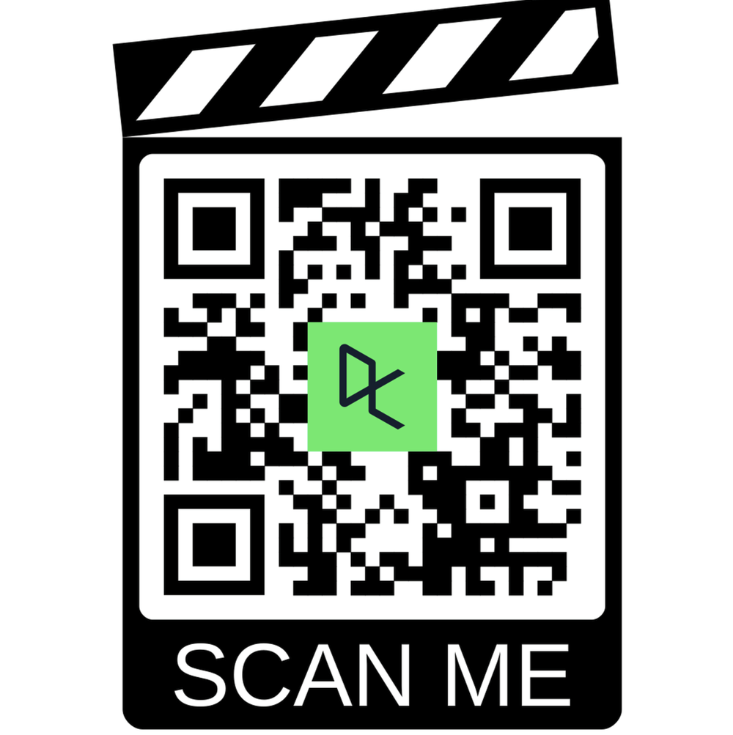
UI + Deployment + QR Code
Deployed Streamlit app:
Link: https://movie-dialog-chatbot.streamlit.app/
Deployment approach
App downloads index bundle from Hugging Face dataset repo:
NMSudarsan/movie-dialog-index
Avoids building 450MB index on Streamlit
QR Code:

